Slide 1
Personal Computing
EN1301
Word Processing Applications (12 hrs.)

Slide 2
Instructional Objectives
 Explain word processing
 Distinguish different word processing applications
 Discover the different features of a word processing application
 Prepare different types of documents using available functionality
 Use and apply macros
 Apply and work with advanced options

Slide 3
Sub Topics
 Introduction to Word Processing
 Get Started with Word Processing Applications
 Document formatting
 Working with Graphics and objects
 Working with Tables
 Creating a Booklet
 Mail Merge
 Document collaboration
 Working with Macros
 Advanced Writer Options

Slide 4
Introduction to Word Processing
Word Processing ?
Writing, editing, and production of documents, as letters, reports, and books, through the use of a computer program or a complete computer system designed to facilitate rapid and efficient manipulation of text. [Dictionary.com]

Slide 5
Introduction to Word Processing
History
  Read History of Word Processing@http://users.ipfw.edu/jehle/deisenbe/compartics/History_of_Word_Processing.pdf
    Published in: Encyclopedia of Library and Information Science, vol. 49 (New York: Dekker, 1992), pp. 268-78

Slide 6
Introduction to Word Processing
Examples
  Proprietary
    Microsoft Word, WordPerfect, Lotus Word Pro
  Free and Open Source
    Abiword, Kword, LyX, OpenOffice.org Writer, LibreOffice Writer ...etc
  Online
    Google Docs, EtherPad, WriteOnline ...etc
For more information refer: http://en.wikipedia.org/wiki/List_of_word_processors

Slide 7
Get Started with Word Processing Applications
Before moving to this section you MUST
  DOWNLOAD & INSTALL OpenOffice.org 4.0
  http://www.openoffice.org/download/index.html
For more information
  Ref2 : pp10 – pp 17
The next few sections will be based on
  OpenOffice.org Writer

Slide 8
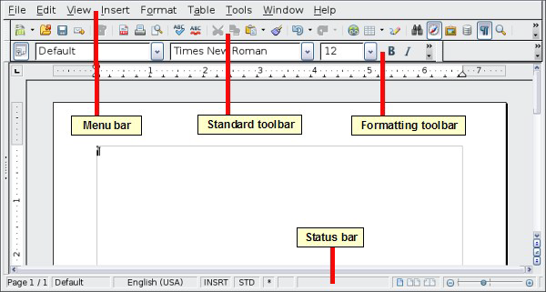
Working Environment
For more information
  Ref3 : p10 - p17

Slide 9
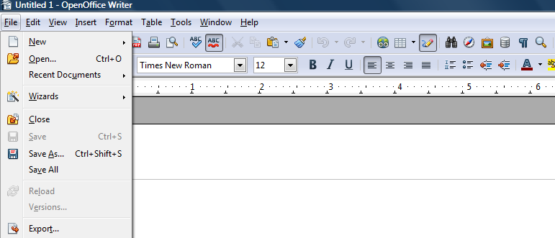
Basic File Operations
For basic file operations refer
  Ref3: p17 - p23

Slide 10
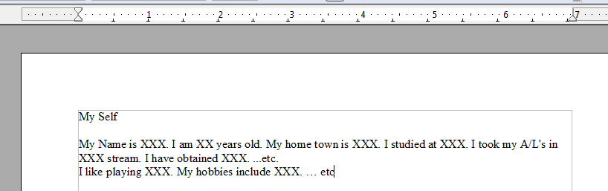
Typing a simple document
Type a simple essay about your self using OpenOffice.org Writer and Save it as “Exercise 1_Typing”
HINT

Slide 11
Typing a simple document
Open OpenOffice.org Writer
Type the essay.
Press enter key on the keyboard to go to a new line.
To Save
  Go to File ->Save
  Select the drive and the folder
  Type “Exercise 1_Typing” on Files Name
  Click “Save”

Slide 12
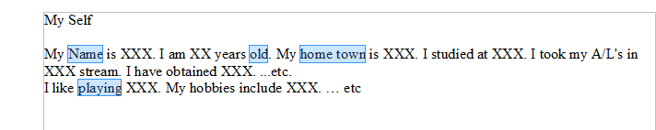
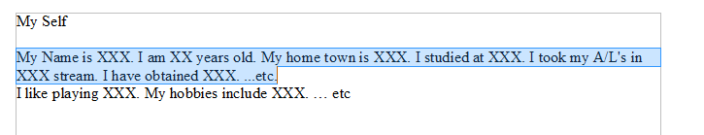
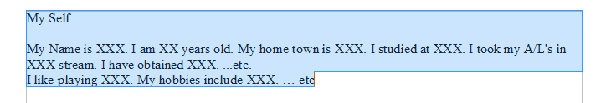
Text Selection Techniques
Try out the following.
1
2
3
HINT
Ref3: p63 – p64

Slide 13
Text Selection Techniques
Select one word → Hold Ctrl → Select rest
Bring the cursor to the beginning of the sentence → Hold left mouse button→ Select the sentence
Challenge: try the same using arrow keys while holding the Shift button.
Go to Edit →Select All
Note: This is only one way to do the selection. Try out other means.

Slide 14
Copy, Cut & Paste
Open “Exercise1_Part2.odt” file
Copy “Copy this text” sentence
Paste it 5 times on the same document.
Cut “Cut this text” sentence
Paste it on the beginning of the page 2 times.
Save as “Exercise1_Part2Ans”
Ref3: p64 - p65
HINT

Slide 15
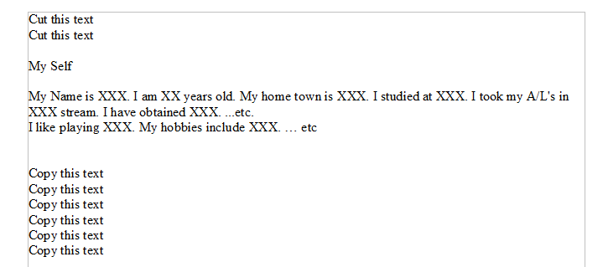
Copy, Cut & Paste
To Copy
  Select the text
  Edit → Copy
  Right click →Copy
  Ctrl →C
To Cut
  Select the text
  Edit → Cut
  Right click →Cut
  Ctrl →X
To Paste
  Copy / Cut Text
  Edit → Paste
  Right click →Paste
  Ctrl →V
Challenge : Try out “Paste Special”

Slide 16
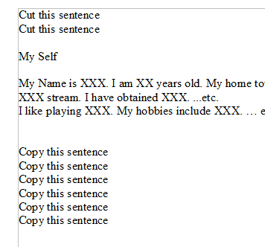
Find & Replace
Open “Exercise1_Part1Ans.odt”
Replace the word “text” using the word “Sentence”
Ref3: p65 - p68
HINT

Slide 17
Find & Replace
Go to Edit → Find & Replace or Press Ctrl + F
Type the following
  Search for – text
  Replace with – sentence
Click “ Replace All”
Challenge: Try out other means and possibilities. Check out more options.

Slide 18
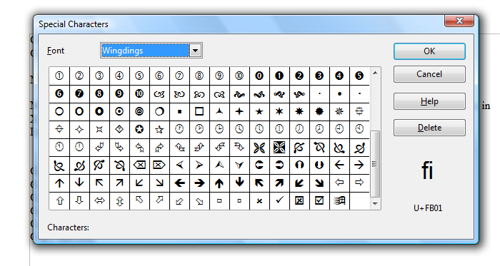
Inserting special characters
Try and see how to insert special characters from
  Insert → Special Character
Ref: p68 - p70

Slide 19
Document Formatting
Read Ref3: p70 – p92 & p97 - p101
Now open “Exercise2.odt”
Format the document to match the formatting given in “Exercise2_Ans.pdf”
Save as “Exercise2_Ans.odt”
HINT

Slide 20
Document Formatting
In this exercise you may learn
  Character formatting : Bold, BoldItalic, Italic, Underline, Hyperlink, Font effects(Change case), Font Color
  Paragraph formatting : Indents & Spacing, Alignment, Borders
  Bullets & Numbering
  Manual breaks
  Page formatting: Header, Footer
  Spelling & Grammar

Slide 21
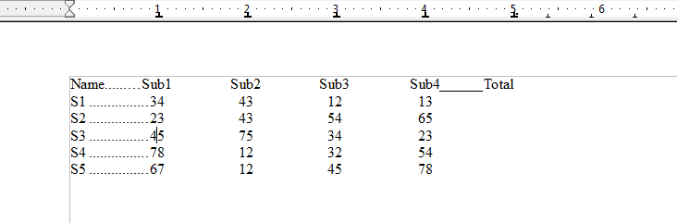
Document Formatting
Open “Exercise3.odt”
Format the given data to view the following and Save as “Exercise3_Ans.odt”.
Ref3: p72 - p73
HINT

Slide 22
Document Formatting
Select the given Data
Go to “Format → Paragraph”
Select “Tabs”
Set the following Position, Type & Fill Character respectively and Click OK.
  1.0, Centered, …...
  2.0, Centered, None
  3.0, Centered, None
  4.0, Centered, None
  5.0, Decimal, _______
Use the Tab Key on the Keyboard to format the given Paragraph.

Slide 23
Page Formatting
Ref3: p102 – p144
Challenge: Try out the following
  Page layouts
  Page background
  Page Header & Footer
  Page borders
  Columns
  Footnotes

Slide 24
Working with Graphics & Objects
Read Ref3: p236 – p263
Try out the drawing tools.
Add an image to a document.
Format the image as desired.
Challenge : Create an image map

Slide 25
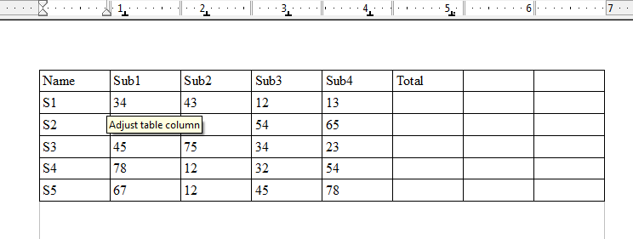
Working with Tables
Ref3: p265 - p287
Open “Exercise3_Ans.odt”
Convert the data into a table using
“ Table→ Convert → Text to Table” to get the following.

Slide 26
Working with Tables
View Table
Delete the last two empty columns.
Calculate the Total.
Insert two more rows to the bottom of the table.
Name one row as “Maximum” and the other as “Minimum”
Calculate the maximum and minimum values for each subject.
Format the table using Auto Format Option.
Sort the data using the field “Total”.

Slide 27
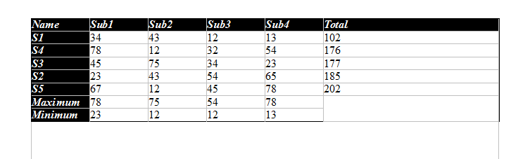
Working with Tables
At the end of this exercise you will learn
  Basic table operations
  Formatting tables
  Converting techniques
  Sorting and Calculations

Slide 28
END of PART 1
Topics covered
  Introduction to Word Processing
  Get Started with Word Processing Applications
  Document formatting
  Working with Graphics and objects
  Working with Tables
Next go to PART 2

Slide 29
PART 2
Topics to be covered
  Creating a Booklet
  Mail Merge
  Document Collaboration
  Working with Macros
  Advanced Writer Options.

Slide 30


